Slide 1
Adversarial Examples
Generative Adversarial Networks
Presenter: Efstathios Chatzikyriakidis
M.Sc. in Computational Intelligence and Digital Media, Aristotle University of Thessaloniki
B.Sc. in Informatics and Communications, Technological Educational Institute of Central Macedonia
Email : stathis.chatzikyriakidis@medoid.ai Website : http://www.efxa.org/

Slide 2
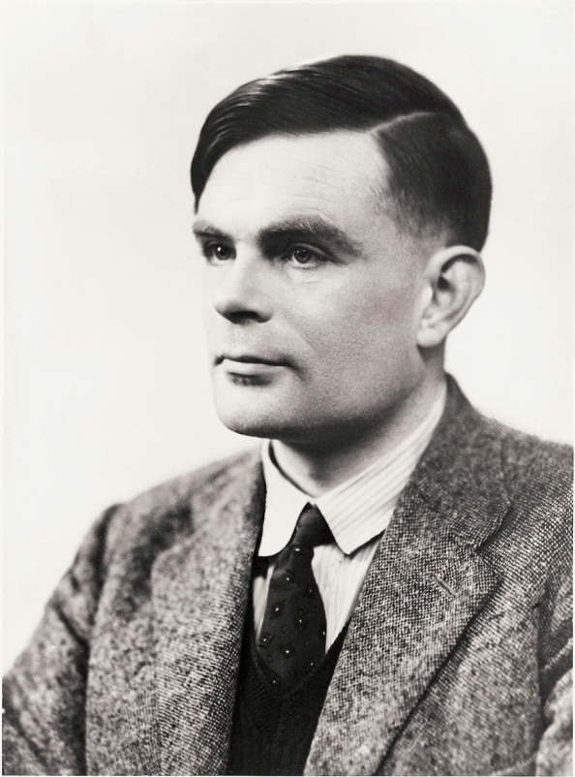
Introduction
Thoughts on Machine Intelligence
Alan Turing, “Computing Machinery and Intelligence”, 1950
“Can machines think?” (this was a really difficult question)
“Can machines do what we can do?” (this question was more promising)
“Can a machine act indistinguishably from the way a thinker acts?” (Turing Test)
So, when the machines become intelligent we will not be able to prove that they are not

Slide 3
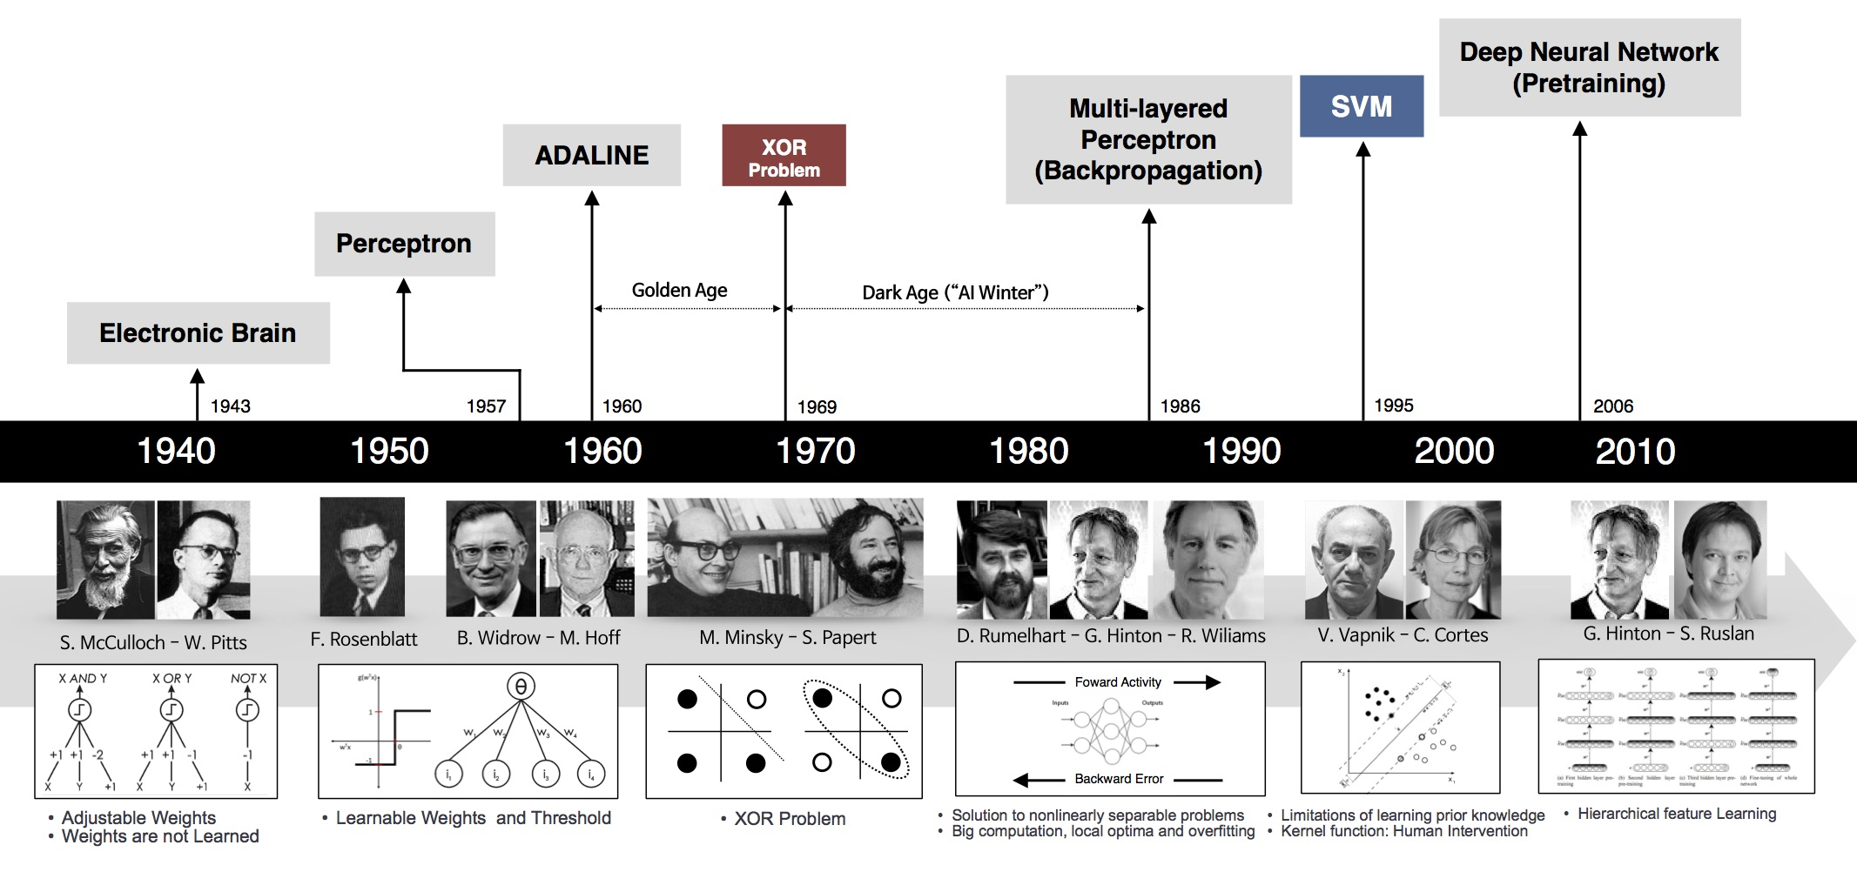
Introduction
Important history of Artificial Intelligence
We had a long journey… and we are still at the birth of it...

Slide 4
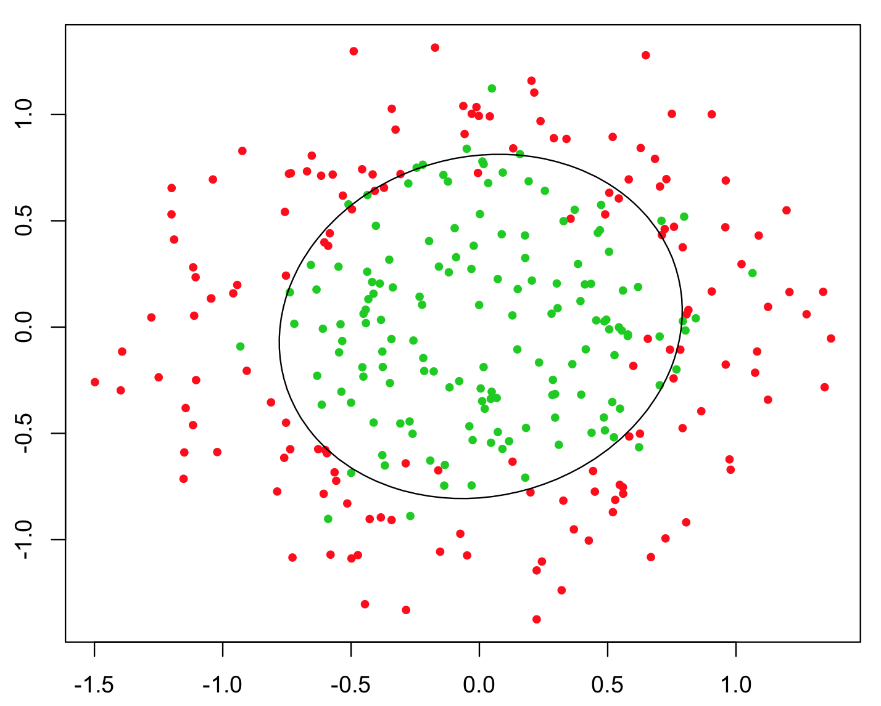
Introduction
Αdvantages of Artificial Neural Networks
Satisfactory separation of non-linear separable input data

Slide 5
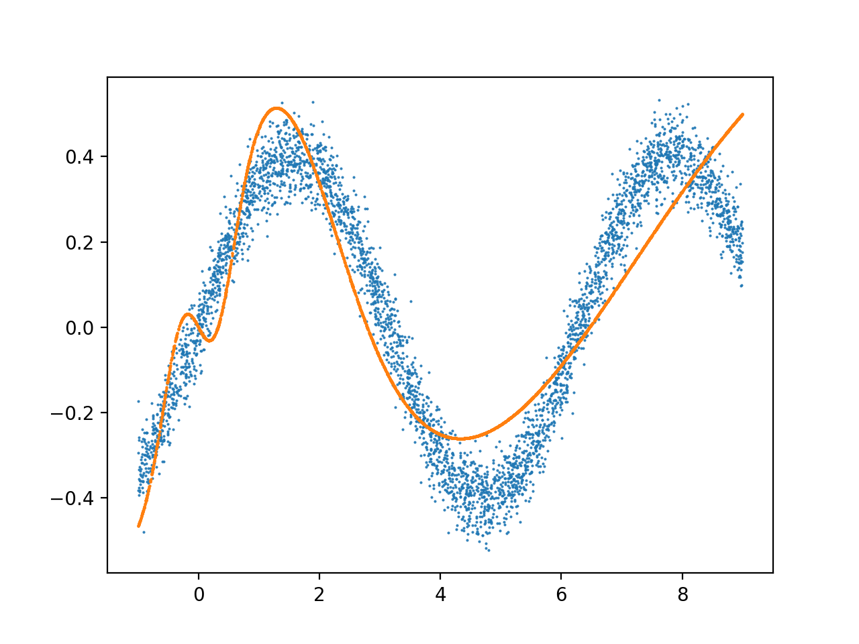
Introduction
Advantages of Artificial Neural Networks
Universal Approximation Theorem (George Cybenko)
Satisfactory function approximation using only input data

Slide 6
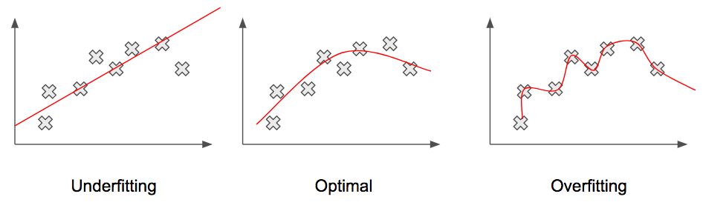
Introduction
Αdvantages of Artificial Neural Networks
Good generalization that captures the general manifold of data

Slide 7
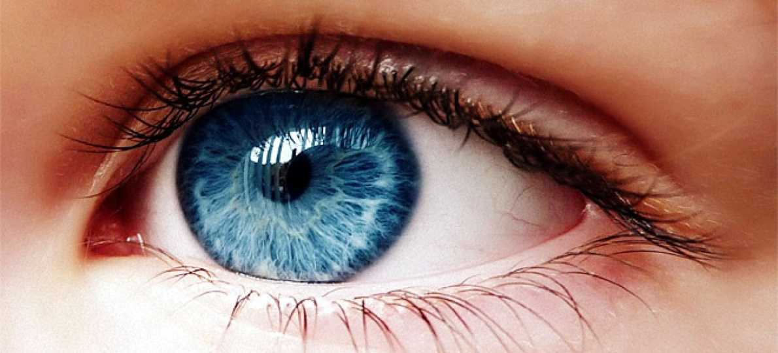
Introduction
Computer Vision and its future goal
The strongest sense of most animal species
Simulate how brains see and understand the world through vision sense

Slide 8
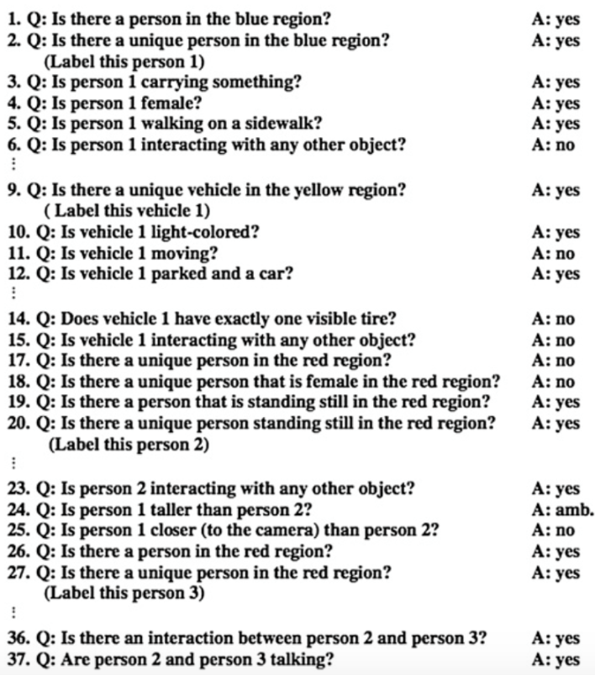
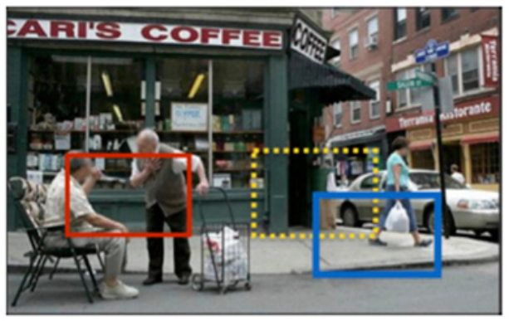
Introduction
Computer Vision and its future goal
Visual Turing Test

Slide 9
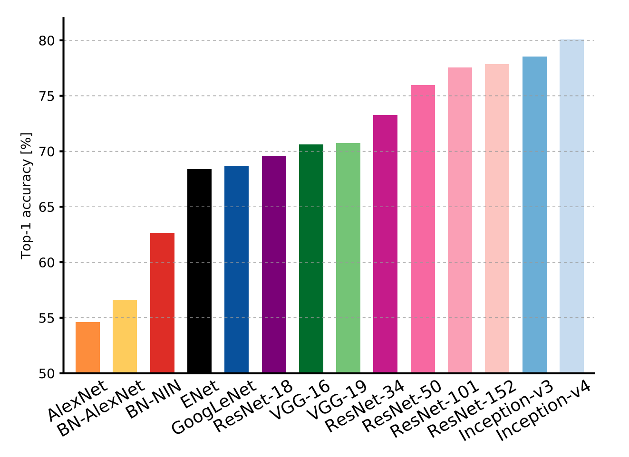
Introduction
State-of-the-art Computer Vision
ImageNet Large Scale Visual Recognition Challenge (ILSVRC)

Slide 10
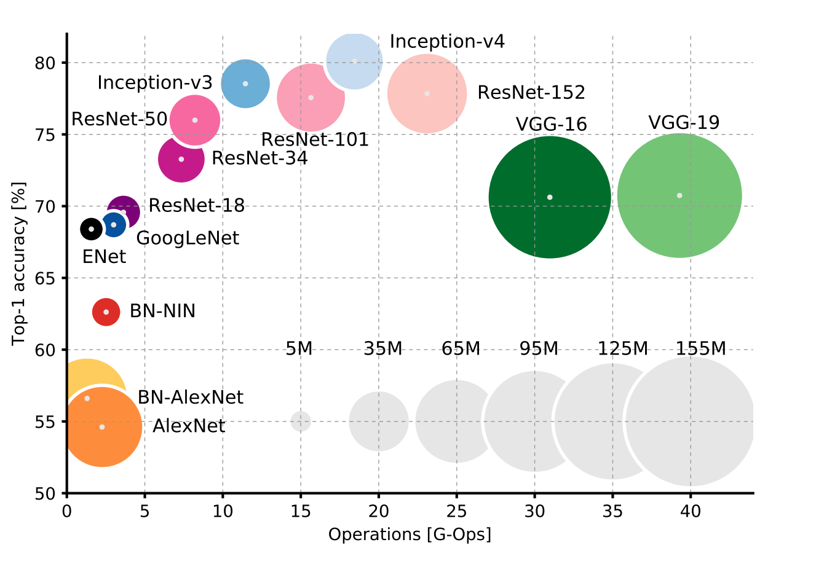
Introduction
State-of-the-art Computer Vision
ImageNet Large Scale Visual Recognition Challenge (ILSVRC)

Slide 11
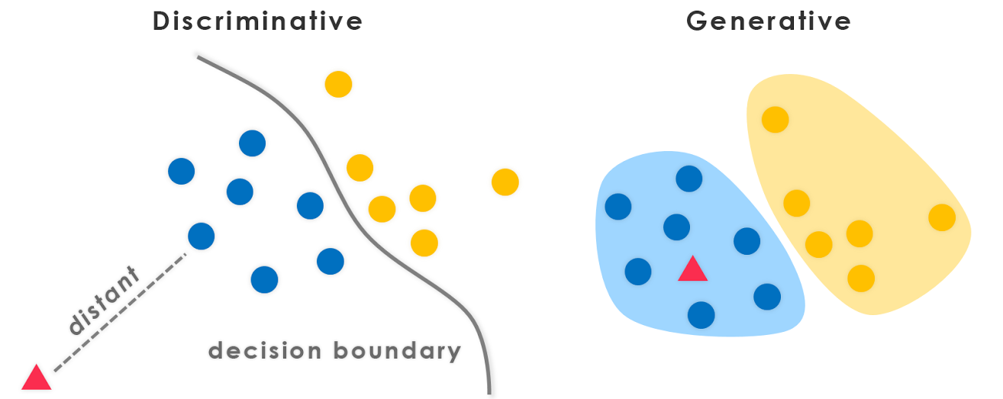
Introduction
Discriminative and Generative models

Slide 12

Introduction
Discriminative and Generative models
In the past years we have focused mostly on building discriminative models for classification and regression

Slide 13
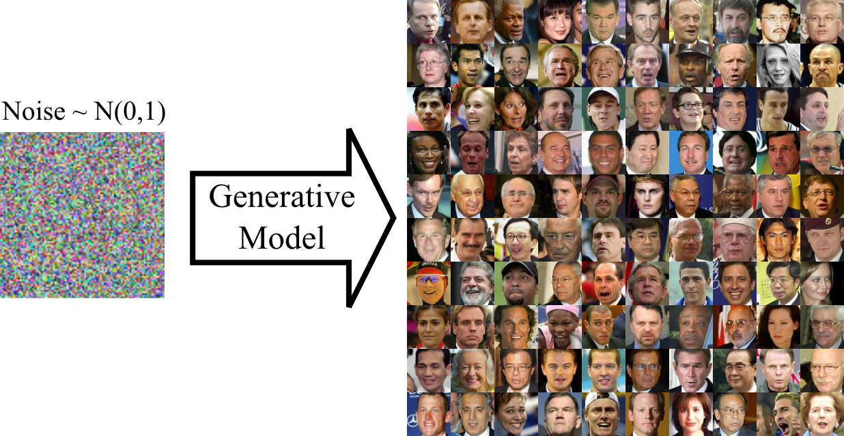
Introduction
Discriminative and Generative models
Nowadays, we are focusing also on generative models for generating artificially realistic data

Slide 14
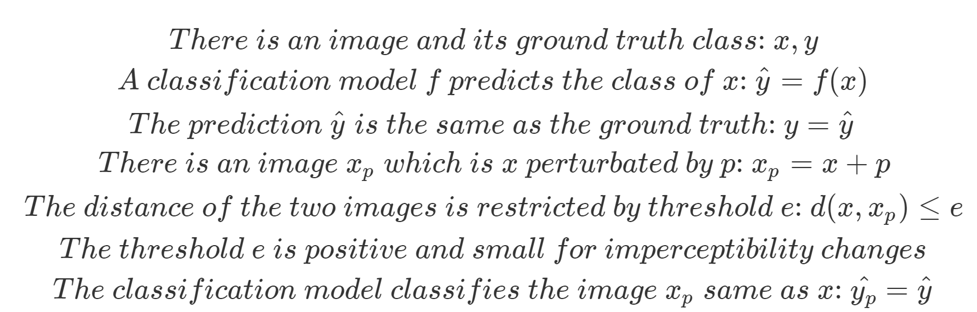
Adversarial Examples
Local Generalization in Computer Vision
Slight pixel changes should not affect the decision of a model

Slide 15
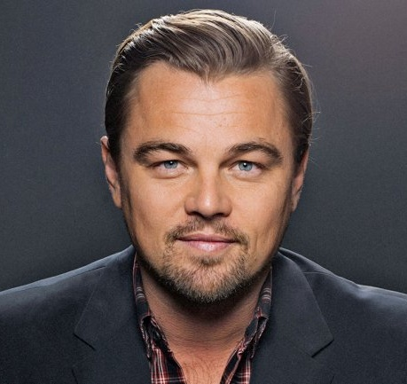
Adversarial Examples
Local Generalization in Computer Vision
Slight pixel changes should not affect the decision of a model

Slide 16
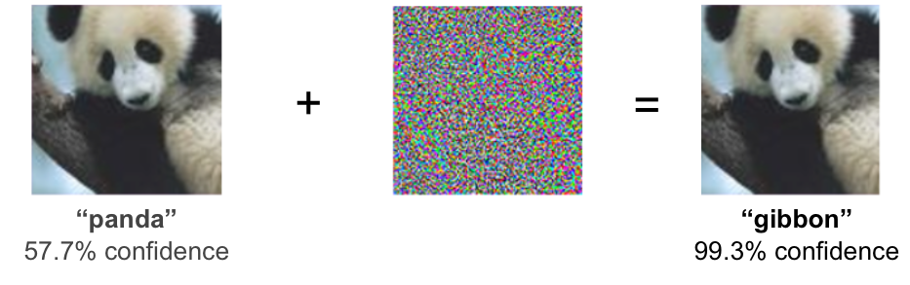
Adversarial Examples
What exactly are these?
Examples where the Local Generalization does not apply
Perturbation: Optimal direction to move all the pixels so that the model will do a mistake
Most models fail to work (LR, Softmax Regression, SVM, k-NN, Decision Trees, Neural Nets, Ensembles)

Slide 17
Adversarial Examples
Important related papers
Fooling a spam filter
“Adversarial Classification”
Nilesh Dalvi et al, 2004
Fooling neural networks
“Evasion Attacks Against Machine Learning at Test Time”
Battista Biggio et al, 2013
Fooling ImageNet classifiers
“Intriguing properties of neural networks”
Christian Szegedy et al, 2013
Cheap, closed form attack
“Explaining and Harnessing Adversarial Examples”
Ian J. Goodfellow et al, 2014

Slide 18

Adversarial Examples
The big question
Why adversarial examples exist and how is it feasible a model that is not overfitted and has high test/validation accuracy not to be functional in adversarial examples which are very similar to the original data?
Morpheus to Neo: “I imagine that right now you're feeling a bit like Alice, tumbling down the rabbit hole.”, The Matrix (1999)

Slide 19
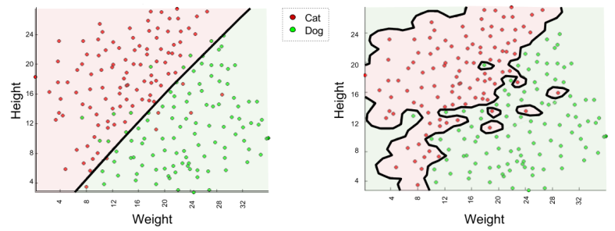
Adversarial Examples
Why do they exist?
Is it due to overfitting?
a) an overfitted model is sensitive to small input changes since it learns the idiosyncrasies of input

Slide 20
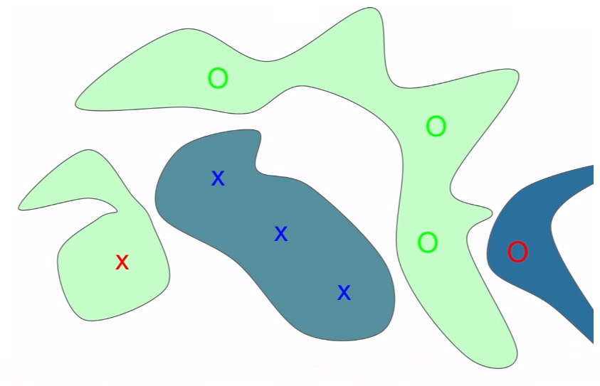
Adversarial Examples
Why do they exist?
Is it due to overfitting?
b) an overfitted model assigns some blobs of probabilities mass in unseen places of input

Slide 21
Adversarial Examples
Why do they exist?
If adversarial examples exist due to (a) and (b) then these are just the result of bad luck and should not be transferable between different model settings since different models give different probabilities in unseen places of input.
However, the adversarial examples are transferable between different model settings and that seems that is something more systematic than random.

Slide 22
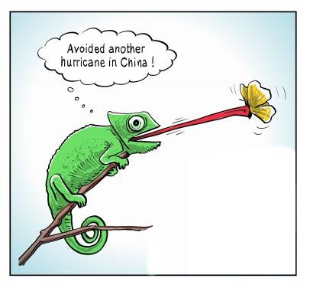
Adversarial Examples
Why do they exist?
Latest research supports that it is due to high-dimensional input and linearity of models
Many small pixel changes in high-dimensional input lead all together to a huge negative side effect

Slide 23
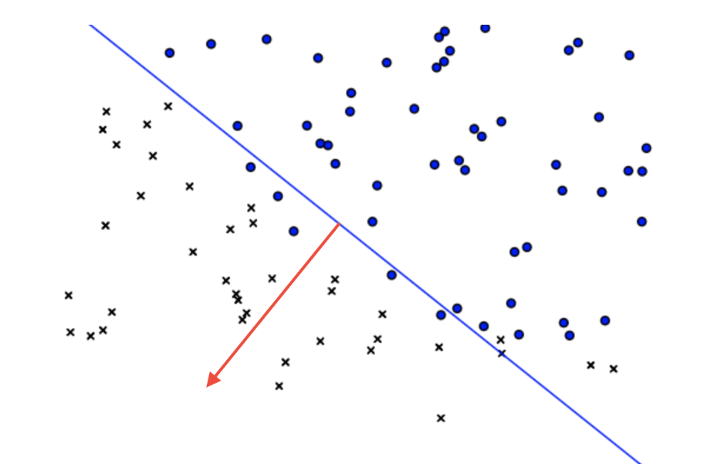
Adversarial Examples
Why do they exist?
Linear models are quite pathological outside of the region where training data is concentrated (initial experiments with shallow linear models shown that this affects greatly the w^{T}x calculation and leads to wrong misclassification)

Slide 24
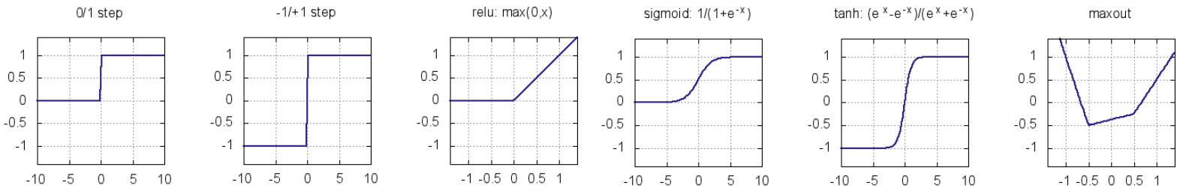
Adversarial Examples
Why do they exist?
Why adversarial examples exist also in non-linear models (e.g. Neural Networks)? Although by definition these are non-linear, are designed knowingly to be piecewise linear. Nowadays, state-of-the-art deep models have various piecewise linear elements.
“The fault is not in our stars, but in our activation functions, for they are piecewise linear”
“Explaining and Harnessing Adversarial Examples”, 2014
Ian J. Goodfellow, Jonathon Shlens, Christian Szegedy

Slide 25
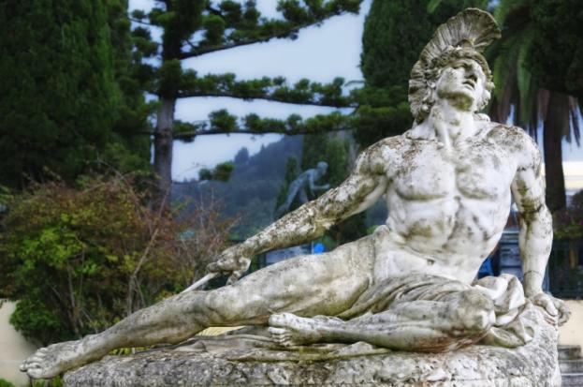
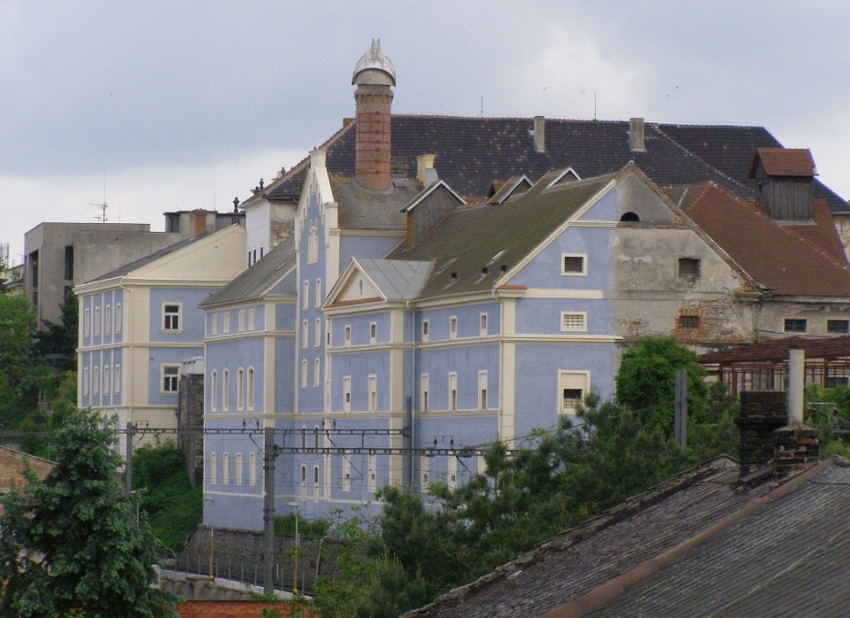
Adversarial Examples
Where does this lead us?
Achilles Heel
Potemkin Village

Slide 26
Adversarial Examples
How useful they are?
Adversarial examples can be used:
to evaluate the robustness of a model
to attack a model in order to break it
in model training as a defensive regularization technique
concealment / misclassification (e.g: de-detection / de-identification)

Slide 27
Adversarial Examples
Multiple ways to create them!
Random / Non-random input
Attack Method Frequency
Adversarial Specificity
Perturbation Scope
Perturbation Measurement
Realistic / Non-realistic Output
Adversarial Falsification
Adversary Knowledge
Attack Method

Slide 28
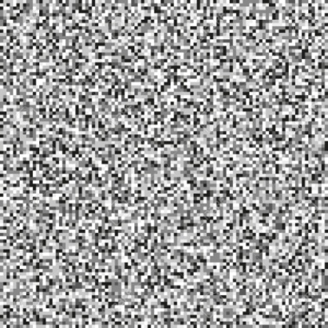
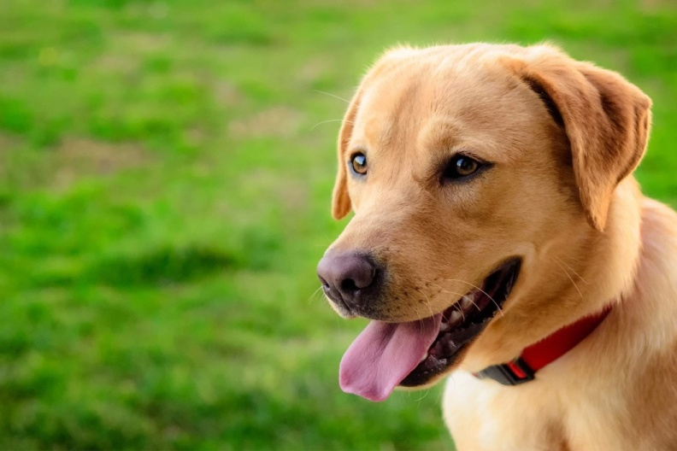
Adversarial Examples
Random / Non-random input
Random: From uniform, Gaussian (normal) or other probability distribution
Non-random: Any example from the training / validation / test data set

Slide 29
Adversarial Examples
Attack Method Frequency
One-time: Take only one time to optimize adversarial examples
Iterative: Multiple times to update the adversarial examples
Adversarial Specificity
Targeted: Find an input that is misclassified as a specific label
Non-targeted: Find an input that is misclassified in a label just different than the ground truth

Slide 30
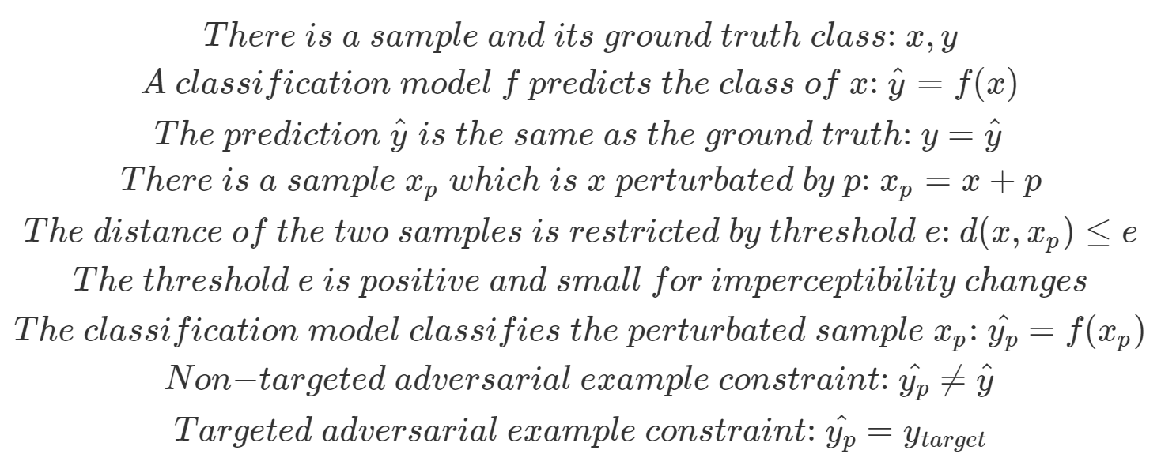
Adversarial Examples
Targeted / Non-targeted Definition

Slide 31
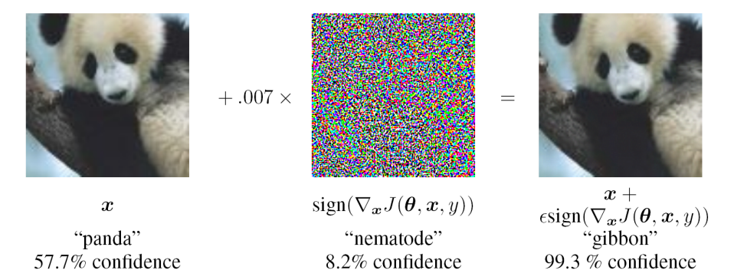
Adversarial Examples
Perturbation Scope
Individual: Each image has its own individual perturbation

Slide 32
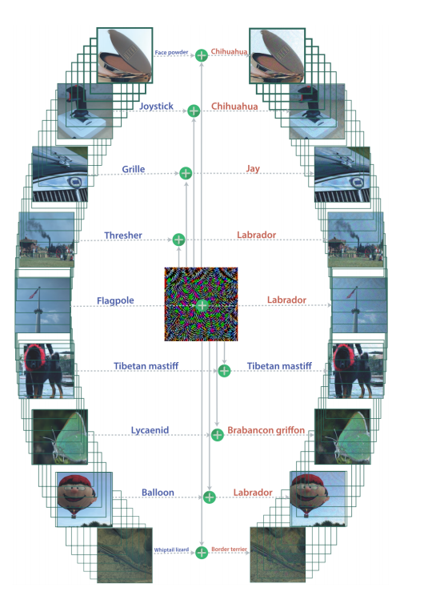
Adversarial Examples
Perturbation Scope
Universal: A universal perturbation for the whole dataset

Slide 33
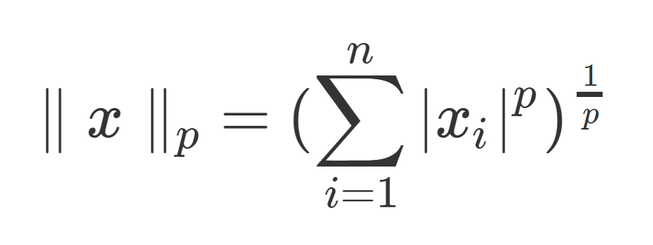
Adversarial Examples
Perturbation Measurement
Use an l_{p}-norm to calculate the magnitude of the adversarial perturbation:
l₀-norm (The total number of non-zero values in the vector)
l₁-norm (The sum of the absolute values in the vector)
l₂-norm (The square root of the sum of the squares of the values in the vector)
l∞-norm (The maximum of the absolute values in the vector)

Slide 34
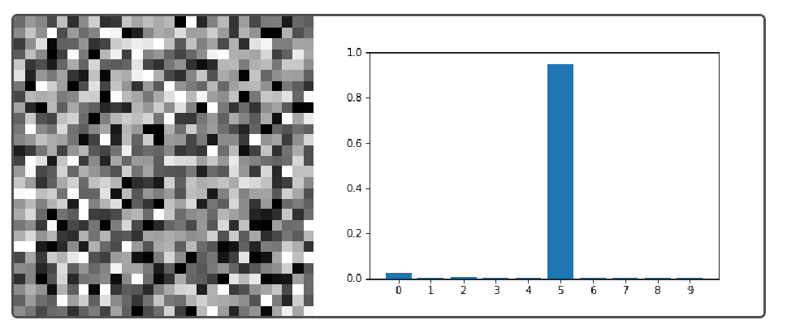
Adversarial Examples
Realistic / Non-realistic Output
Non-realistic: Any adversarial input that fools the model

Slide 35
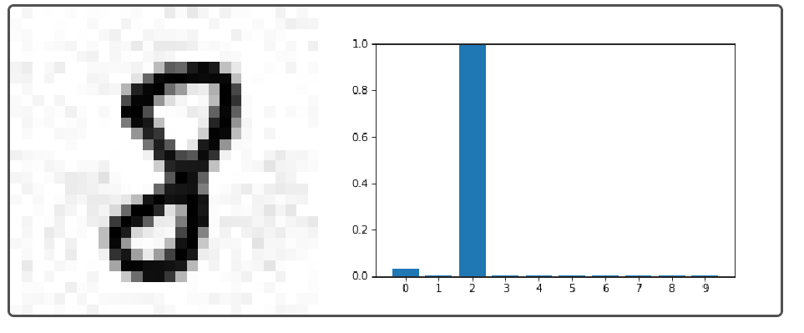
Adversarial Examples
Realistic / Non-realistic Output
Realistic: An adversarial input that is close to a target example

Slide 36
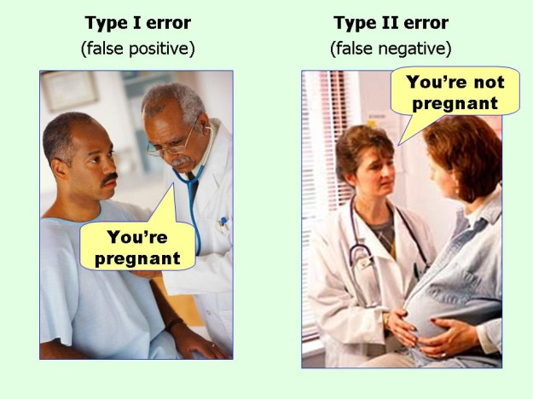
Adversarial Examples
Adversarial Falsification
Type 1 error: Negative sample classified as positive
Type 2 error: Positive sample classified as negative

Slide 37
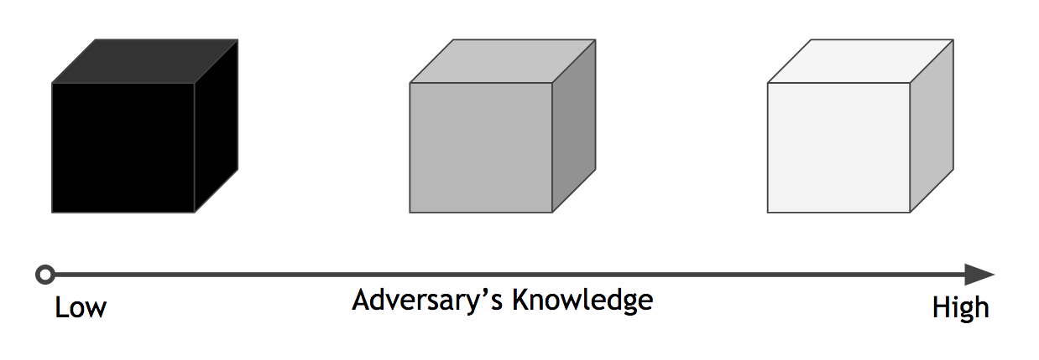
Adversarial Examples
Adversary Knowledge
Black-box: Zero knowledge about the model to attack (knowing only the final classification)
Grey-box: Limited knowledge about the model to attack (something between Black-box and White-box)
White-box: Full knowledge about the model to attack (architecture, parameters, dataset, etc)

Slide 38
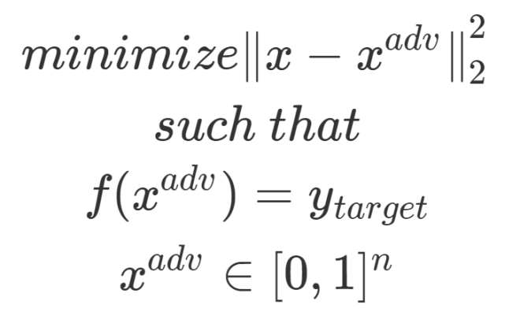
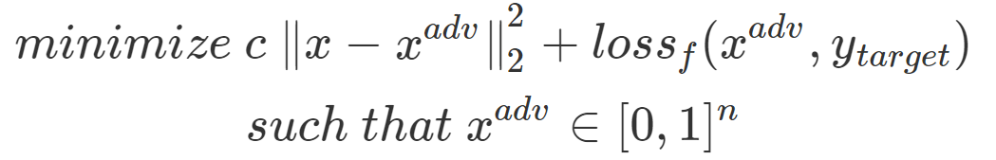
Adversarial Examples
Attack Methods
L-BFGS: Limited-memory BFGS
Intriguing properties of neural networks
Christian Szegedy et al, 2013
Given an input image x, the method finds a targeted adversarial valid image x^{adv} that is similar to x under squared l₂-norm and is labeled as y_{target} by the classifier f. However, this problem can be very difficult to solve. So, instead solve the following problem:

Slide 39
Adversarial Examples
Attack Methods
Let’s get an idea with “Fast Gradient” Methods
Explaining and Harnessing Adversarial Examples
Ian J. Goodfellow et al, 2014

Slide 40
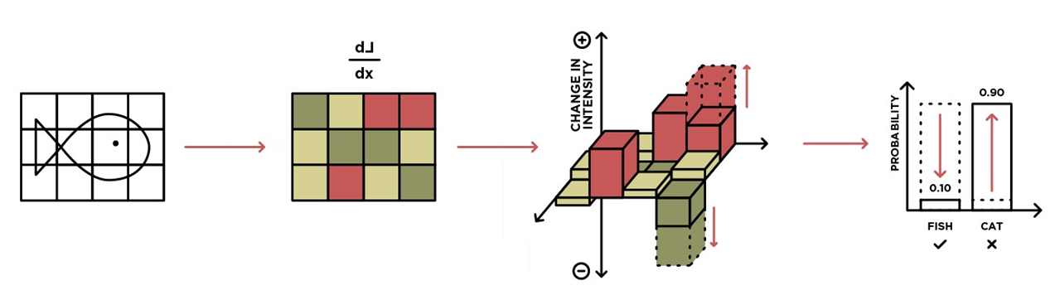
Adversarial Examples
Attack Methods
Use gradients of loss function w.r.t. input
Gradient descent for targeted or ascent for non-targeted
Very effective for the domain of image
Fast and easy to compute
‘ε’ controls the size of the change (should be a small value)
Can be used for run-time adversarial training
For NNs the ∇_{x} J(θ, x, y) can be calculated with backpropagation

Slide 41
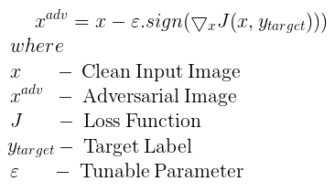
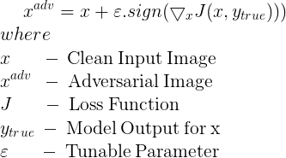
Adversarial Examples
Attack Methods
FGSM : Fast Gradient Sign Method
Non-targeted: One-shot method with gradient ascent
Targeted: One-shot method with gradient descent

Slide 42
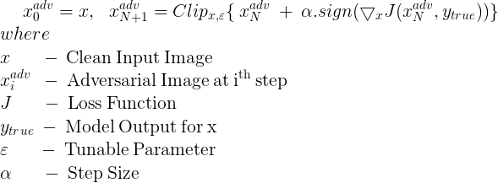
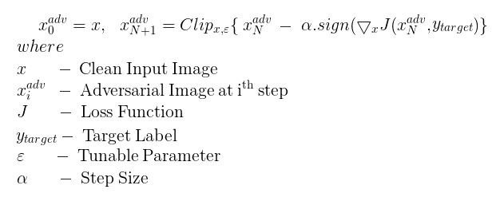
Adversarial Examples
Attack Methods
I-FGSM : Iterative Fast Gradient Sign Method
Non-targeted: Iterative method with gradient ascent
Targeted: Iterative method with gradient descent

Slide 43
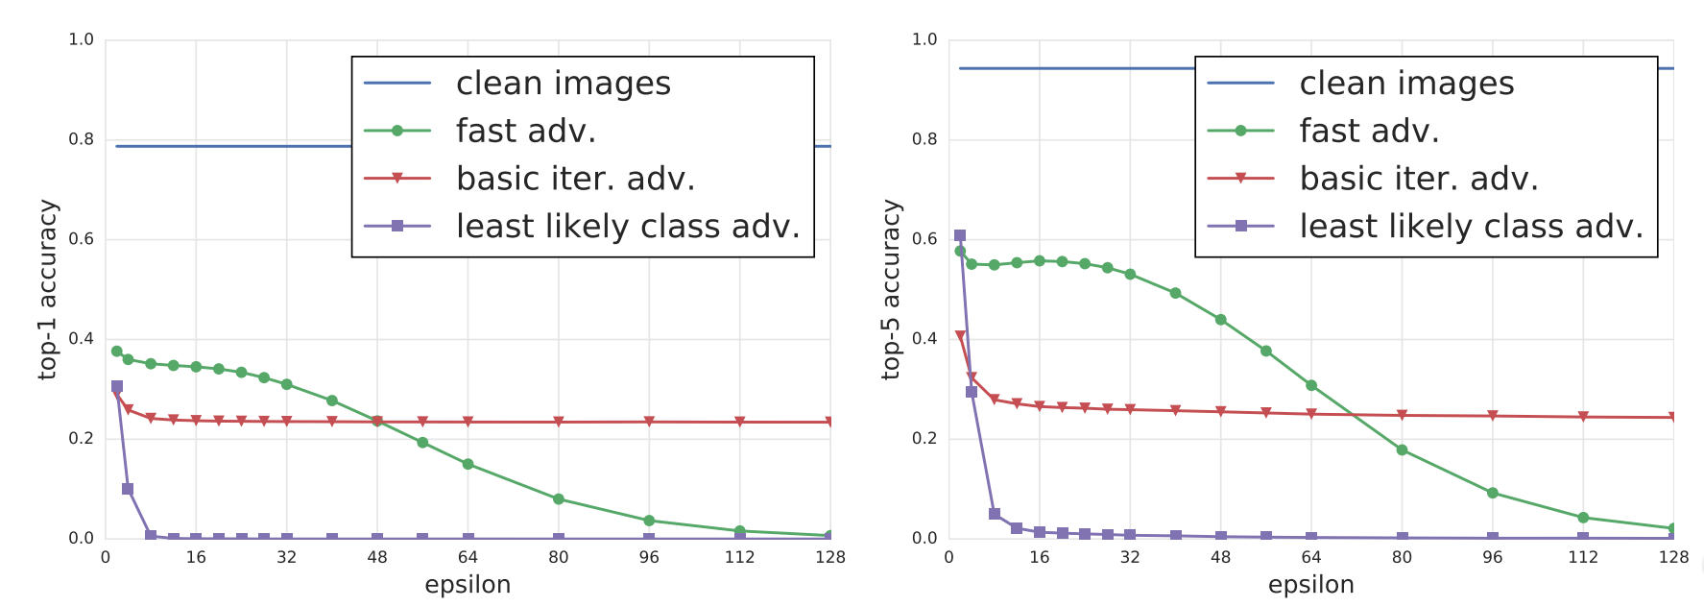
Adversarial Examples
Attack Methods
Iterative Least-Likely Class Method
Using I-FGSM with y_{target} = argmin_{y}{ p(y|x) }
Top-1 and Top-5 accuracy of Inception V3 under attack by different adversarial methods and different ‘e’ compared to unmodified images from the dataset. The accuracy was computed on all 50,000 validation images from the ImageNet dataset.

Slide 44

Adversarial Examples
Attack Methods
What would be more crazy? Of course, “Single Pixel” attack!
One pixel attack for fooling deep neural networks
Jiawei Su et al, 2017

Slide 45
Adversarial Examples
Attack Methods
L-BFGS (Szegedy et al, 2013)
Fast Gradient Sign Method (Goodfellow et al, 2015)
Basic Iterative Method (Kurakin et al, 2016)
One Pixel (Jiawei Su et al, 2018)
DeepFool (Moosavi-Dezfooli et al, 2015)
Jacobian-based Saliency Map Method (Papernot et al, 2016)
SPSA (Uesato et al, 2018)
Carlini Wagner L2 (Carlini and Wagner, 2016)
Feature Adversaries (Sabour et al, 2016)
Elastic Net Method (Chen et al, 2017)
Virtual Adversarial Method (Miyato et al, 2016)
The Momentum Iterative Method (Dong et al, 2017)
Projected Gradient Descent (Madry et al, 2017)

Slide 46
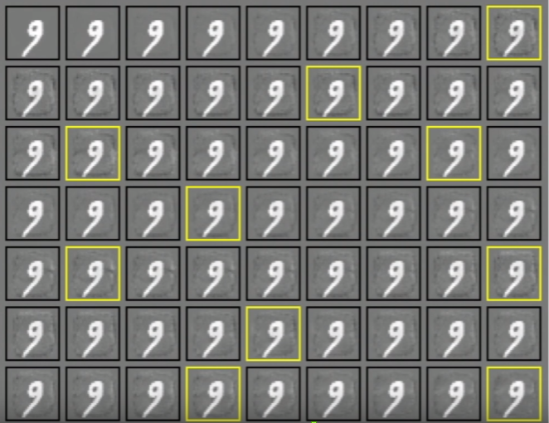
Adversarial Examples
Softmax regression (MNIST)
The first image in the table is a random sample from the training data set
The rest images are generated from top-to-bottom and left-to-right sequentially using L-BFGS
Yellow Boxes: cases with >= 99% probability where the model thinks is 0, 1, …, 9
The animal species recognize all above images as 9 but the model seems different

Slide 47
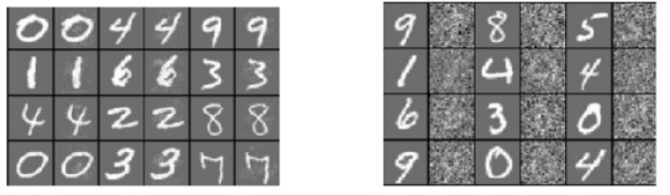
Adversarial Examples
Softmax regression (MNIST)
(a) (b)
Images in table’s odd columns are random samples from the training data set
Images in table’s even columns correspond to distorted counterparts
(a) We successfully classify images with adversarial perturbation but models fail to do it
(b) We fail to classify images with Gaussian noise added but models do it successfully

Slide 48

Adversarial Examples
MLP w/ Ext. Yale Face Database B
An example of face de-identification with an MLP model
Successfully target to any class with non-realistic images

Slide 49
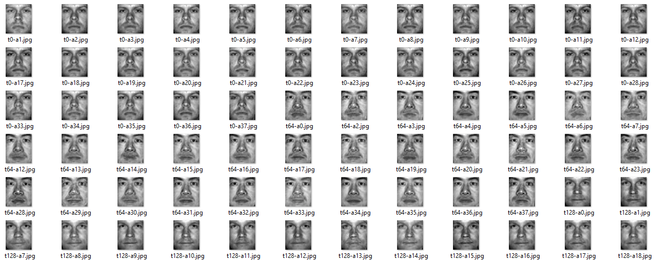
Adversarial Examples
MLP w/ Ext. Yale Face Database B
An example of face de-identification with an MLP model
Successfully target to any class with realistic images

Slide 50
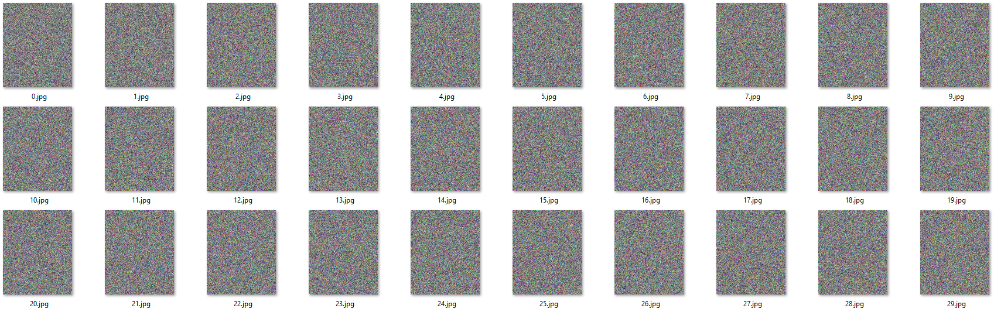
Adversarial Examples
CNN w/ CelebA
An example of face de-identification with a CNN model
Successfully target to any class with non-realistic images

Slide 51
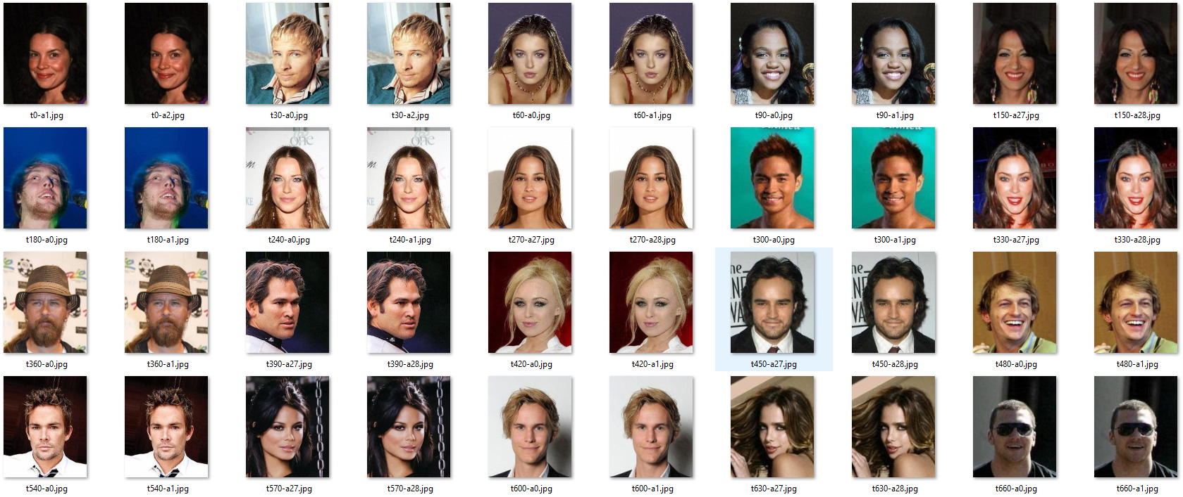
Adversarial Examples
CNN w/ CelebA
An example of face de-identification with a CNN model
Successfully target to any class with realistic images

Slide 52
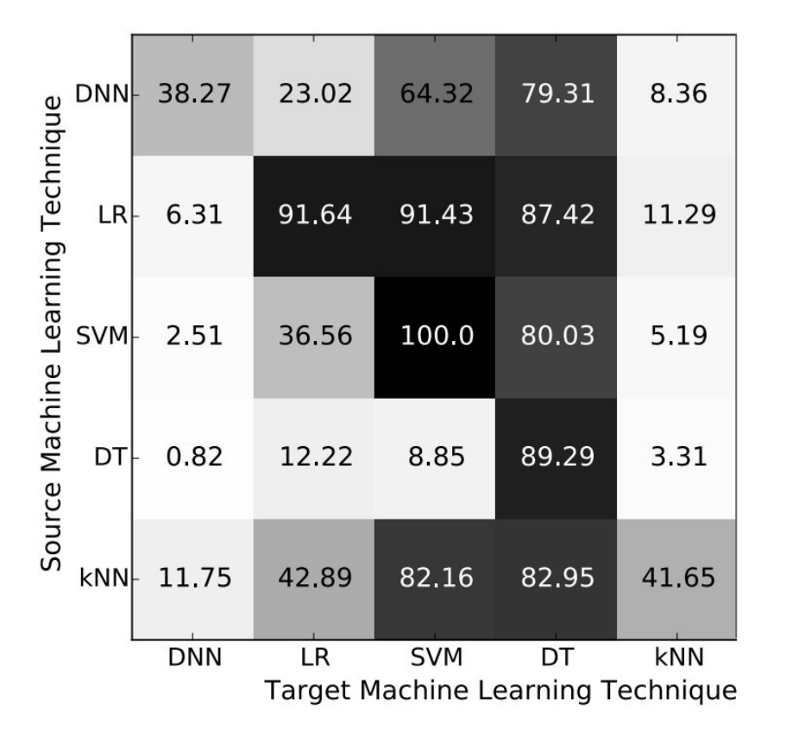
Adversarial Examples
They are transferable!
Cross model generalization

Slide 53
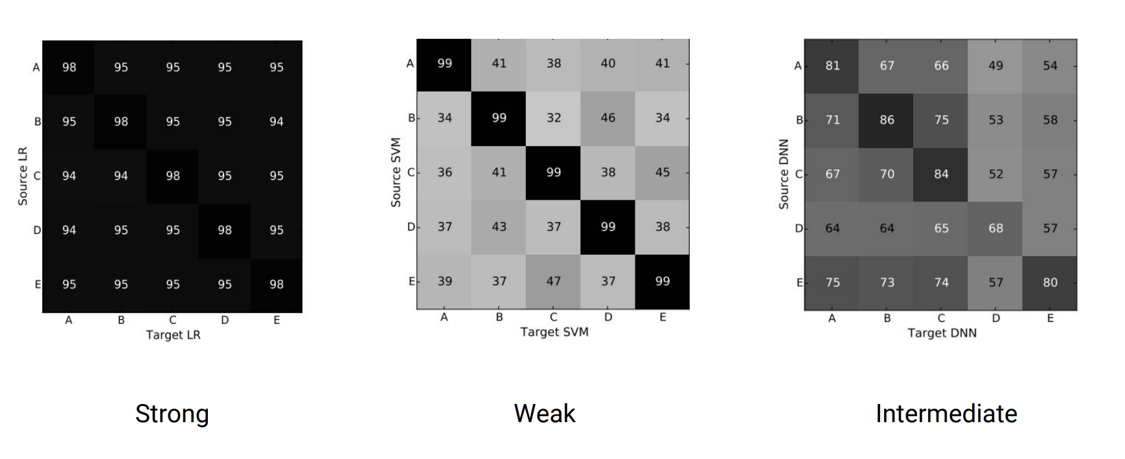
Adversarial Examples
They are transferable!
Cross training-set generalization

Slide 54
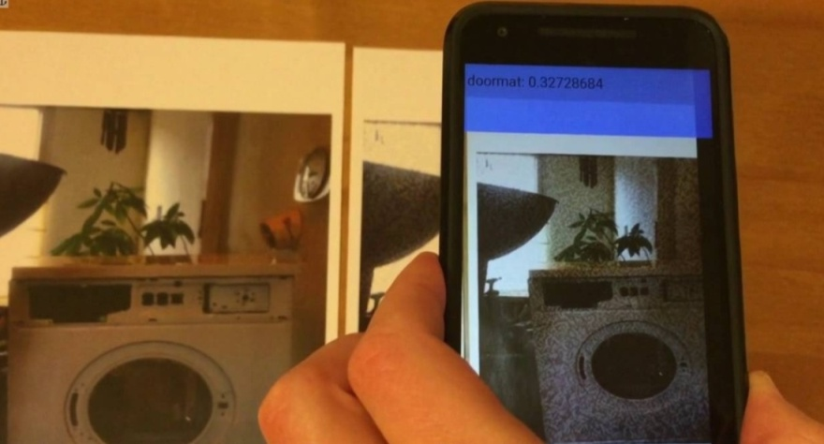
Adversarial Examples
They are transferable!
Can exist to the real world!
Adversarial examples in the physical world
Alexey Kurakin et al, 2017
“We used images taken from a cell-phone camera as an input to an Inception V3 image classification neural network. We showed that in such a set-up, a significant fraction of adversarial images crafted using the original network are misclassified even when fed to the classifier through the camera.”, Kurakin et al.

Slide 55
Adversarial Examples
Adversarial Training
The Neural Networks can approximate any function (Universal Approximation Theorem)
We can train our Neural Networks with some adversarial examples to be more robust
Adversarial training works as a regularization technique
There is a need for sophisticated adversarial training algorithms with robustness by priori

Slide 56
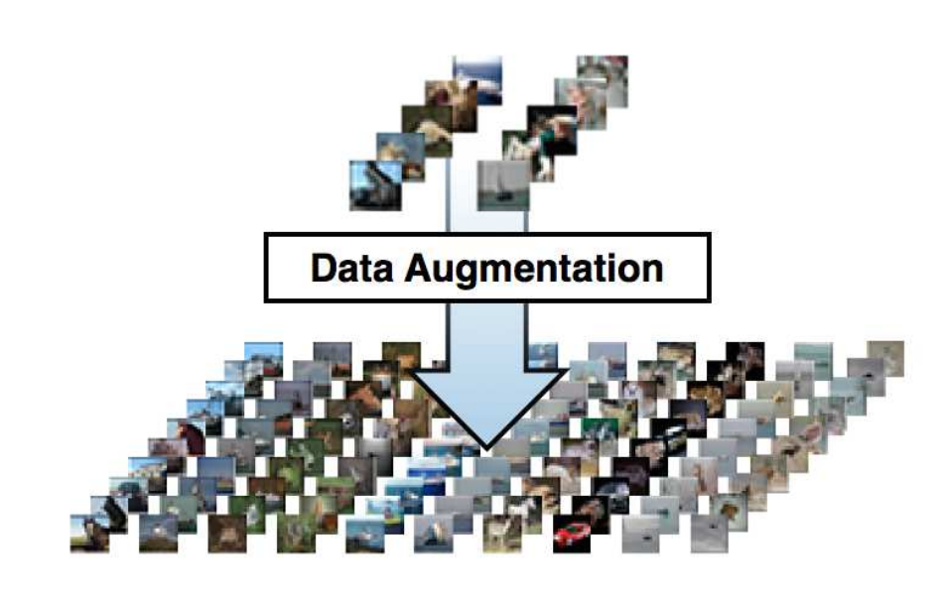
Adversarial Examples
Adversarial Training
Mixing training/validation/testing data sets with adversarial examples
Same idea with data augmentation as a regularization technique

Slide 57
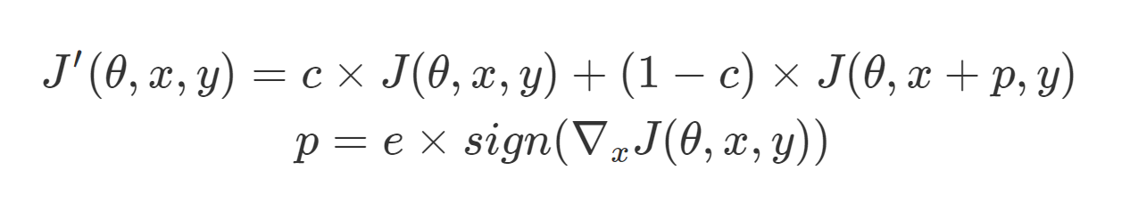
Adversarial Examples
Adversarial Training
Using an adversarial loss function for single examples
Generate fast adversarial examples at run-time with FGSM
‘c’ : hyperparameter coefficient to balance the weight of adversarial learning

Slide 58


Adversarial Examples
Adversarial Training
2016, “Adversarial Machine Learning at Scale”
Alexey Kurakin, Ian Goodfellow, Samy Bengio
Using an adversarial loss function for large scale models and datasets

Slide 59

Adversarial Examples
Adversarial Training

Slide 60

Generative Adversarial Networks
What exactly are these?
Discriminative models map rich, high dimensional data input to low dimensions output
Nowadays, interest has turned quite a bit on generative models which do the opposite
GAN: A framework for evolving adversarially a generative and a discriminative model
Generative model as ‘Generator’ or ‘G’ / Discriminative model as ‘Discriminator’ or ‘D’

Slide 61

Generative Adversarial Networks
What exactly are these?
‘G’ and ‘D’ evolve through an adversarial process
‘G’ and ‘D’ are players in a two-player minimax game
‘G’ is trained to learn to generate fake data and approximate the real data distribution
‘D’ is trained to learn to separate the fake from the real data distribution

Slide 62

Generative Adversarial Networks
What exactly are these?
‘G’ samples random noise ‘z’ from a uniform / normal (Gaussian) distribution
‘G’ generates a fake sample with a single forward pass: x = G(Θ_{G}, z)
‘D’ separates (as a binary classifier) fake from real samples: y = D(Θ_{D}, x)
Optimal solution: Nash Equilibrium where y = 0.5 probability (fake = real)

Slide 63

Generative Adversarial Networks
Adversarial Training
‘G’ and ‘D’ can be trained using backpropagation (in case of NNs)
‘G’ tries to decrease the correct classification of ‘D’ on the fake data
‘D’ tries to increase the correct classification for fake and real data

Slide 64

Generative Adversarial Networks
Adversarial Training
2014, “Generative Adversarial Networks”, Ian J. Goodfellow et al.

Slide 65
Generative Adversarial Networks
Why GANs?
First decent generative model that produces promising results
Ability to approximate the probability distribution of input data through training
Ability to create huge amounts of realistic data (any digital media)
Instead of using data augmentation we can use ‘G' to generate realistic samples
Using it with unsupervised algorithms that need unlabeled data samples
Ability to use convolution layers, autoencoders, regularization techniques
’G’ is not trained on the real dataset as it gets only random input noise

Slide 66
Generative Adversarial Networks
Famous GANs variations
Bidirectional GAN
Conditional GAN
Context-Conditional GAN
CycleGAN
Deep Convolutional GAN
DualGAN
InfoGAN
Pix2Pix
Semi-Supervised GAN
Super-Resolution GAN
400+ named GANs variations exist today (GAN Zoo: https://bit.ly/2sxGUHl)

Slide 67


Generative Adversarial Networks
Applications (Image Synthesis)
2017, “Progressive Growing of GANs for Improved Quality, Stability, and Variation”, Tero Karras et al

Slide 68

Generative Adversarial Networks
Applications (Image Synthesis)
2017, “Towards the Automatic Anime Characters Creation with Generative Adversarial Networks”, Yanghua Jin et al

Slide 69



Generative Adversarial Networks
Applications (Style Transfer)
2017, “Image to Image Translation using Cycle-Consistent Adversarial Neural Networks”, Jun-Yan Zhu et al

Slide 70


Generative Adversarial Networks
Applications (Text-to-Image Synthesis)
2017, “StackGAN: Text to Photo-realistic Image Synthesis with Stacked Generative Adversarial Networks”, Han Zhang et al

Slide 71


Generative Adversarial Networks
Applications (Sketch-to-Image Synthesis)
2016, “Image-to-Image Translation with Conditional Adversarial Networks”, Phillip Isola et al

Slide 72


Generative Adversarial Networks
Applications (3D Object Synthesis)
2016, “Learning a Probabilistic Latent Space of Object Shapes via 3D Generative-Adversarial Modeling”, Jiajun Wu et al

Slide 73

Generative Adversarial Networks
Applications (Image Gap Filling)
2016, “Context Encoders: Feature Learning by Inpainting”, Deepak Pathak el al

Slide 74

Generative Adversarial Networks
Applications (Increase Image Resolution)
2017, “High-Quality Face Image Super-Resolution Using Conditional Generative Adversarial Networks”, Huang Bin et al

Slide 75

Generative Adversarial Networks
Applications (Progressive Face Aging)
2017, “Age Progression/Regression by Conditional Adversarial Autoencoder”, Zhifei Zhang et al

Slide 76

Generative Adversarial Networks
Applications (Music Synthesis)
2016, “C-RNN-GAN: Continuous recurrent neural networks with adversarial training”, Olof Mogren

Slide 77
Conclusions
We have a long journey before we reach human-like high-level Computer Vision
Many knowledge is created in recent years for Adversarial Examples and GANs
400+ named GANs variations exist today (GAN Zoo: https://bit.ly/2sxGUHl)
It is the era where the Generative Models rise
Machine Learning needs to be secure for a safe digital intelligent world
The future of fake digital media is coming and is going to be really dangerous
A lot of fundamental questions need to be well answered
Exploit the vulnerabilites of Neural Networks
Exploit the robustness of Adversarial Examples

Slide 78
Recent Research
Adversarial Examples - GANs
Universal adversarial perturbations (Moosavi-Dezfooli et al, 2016)
Adversarial Machine Learning at Scale (Alexey Kurakin et al, 2016)
Synthesizing Robust Adversarial Examples (Anish Athalye et al, 2017)
Delving into Transferable Adversarial Examples and Black-box Attacks (Yanpei Liu et al, 2017)
Adversarial Examples Are Not Easily Detected: Bypassing Detection Methods (Carlini et al, 2017)
Adversarial vulnerability for any classifier (Alhussein Fawzi et al, 2018)
Adversarial Attacks and Defences Competition (Alexey Kurakin et al, 2018)
Adversarial Logit Pairing (Harini Kannan et al, 2018)
Evolutionary Generative Adversarial Networks (Chaoyue Wang et al, 2018)
Generating Adversarial Examples with Adversarial Networks (Chaowei Xiao et al, 2018)
Robust Conditional Generative Adversarial Networks (Grigorios G. Chrysos et al, 2018)

Slide 79

Thank you a lot and have a nice day!

